Slide 1

SRI RAMAKRISHNA ENGINEERING COLLEGE
[Educational Service: SNR Sons Charitable Trust]
[Autonomous Institution, Reaccredited by NAAC with ‘A+’ Grade]
[Approved by AICTE and Permanently Affiliated to Anna University, Chennai]
[ISO 9001:2015 Certified and all eligible programmes Accredited by NBA]
VATTAMALAIPALAYAM, N.G.G.O. COLONY POST, COIMBATORE – 641 022.
DEPARTMENT OF
BIOMEDICAL ENGINEERING
20BM283 Mini Project II
DESIGN AND DEVELOP 3D PRINTED PLA SCAFFOLDS FOR BONE TISSUE ENGINERING APPLICATION
Presented By
Karthick.k (2107014)
Manimegalai.M (2107021)
Sushmitha.M (2107046)
UNDER THE GUIDANCE OF
Dr.M.Jeevitha Priya M.TECH.,Ph.D
Assitant Professor/BME

Slide 2

CONTENTS
Aim and Objectives
Literature survey
Existing and Proposed Methodology
Previous Work
Software Specification
Results and Discussion
Conclusion and Future Scope
Reference

Slide 3
AIM
To design and develop 3D printed scaffolds using different characterization methods for bone tissue engineering application.
OBJECTIVES
To design and develop 3D printed scaffolds for bone tissue engineering application.
SUB OBJECTIVE:
To design and print the 3D printed scaffold(completed)
Design 3D model using solidworks software
Print designed model using ULTIMAKER 2 (FDM)printer
To Characterize the 3D Printed Scaffold
In silico analysis (Ansys ,Comsol)
Core analysis of the structure by SEM and XRD
To test the printed scaffold by in vitro studies
Antimicrobial testing of the printed scaffold
Cytotoxicity on bone cells

Slide 4
LITERATURE SURVEY
S. No | TITLE | AUTHOR | NAME OF ORGANIZATION &YEAR | DESCRIPTION
1. | A Combined Computational and Experimental Analysis of PLA and PCL Hybrid Nanocomposites 3D Printed Scaffolds for Bone Regeneration | SpyrosV. Kallivokas,Lykourgos C. Kontaxis Spyridon Psarras. | MDPI on Jan,2024. | In this research, combined experimental and computational approaches were used to study and compare mechanical parameters. Overall, a holistic approach was utilized to achieve a delicate balance between structural robustness and optimal fluidic conditions.
2. | Degradation of 3D-Printed Porous Polylactic Acid Scaffolds Under Mechanical Stimulus | Heming Chen,Quan Shi ,Hengtao Peng Wang,Qiang Chen1,Zhiyong Li | Frontiers on oct, 2021. | In this study, the degradation of a 3D-printed porous PLA scaffold under mechanical stimulus was studied by combining the in vitro experiments with the numerical simulations.

Slide 5
Conti..
4. | Design of 3D printed scaffolds for bone tissue engineering | Susheem Kanwar | MDPI-2021 | The 3D Printed Scaffolds act as an extra cellular matrix(ECM) providing a 3D environment for cell adhesion proliferation, differentiation. Designing the scaffolds with desired parameters such as biodegradability has led to further computational analysis.
5. | 3D Bioactive composite scaffolds for bone tissue engineering | Gareth Turnbull | MDPI-2022 | The 3D Printed Scaffolds act as an extra cellular matrix(ECM) providing a 3D environment for cell adhesion proliferation, differentiation. Designing the scaffolds with desired parameters such as biodegradability has led to further computational analysis.
6. | Additive manufacturing of PLA-based scaffolds intended for bone regeneration and strategies to improve their biological properties | Donate, Ricardo, Monzón, Mario and Alemán-Domínguez, María Elena. | Science Direct-2020 | This study contains a description of the specific requirements in the regeneration of bone and how the state of the art have tried to address them with different strategies to develop PLA-based scaffolds by AM techniques and with improved bio functionality.

Slide 6
EXISTING AND PROPOSED METHODOLOGY
EXISTING METHODOLOGY
PROPOSED METHODOLOGY
PLA and its copolymers had been used in wound management such as surgical sutures, healing dental extraction wounds, and preventing postoperative adhesions.
The conventional methods are fabricating the scaffold: solvent casting,particle leaching ,freeze-drying ,gas foaming,Electrospining
The degradation of PLA is from hydrolysis, in which it releases lactic acid monomers that are not toxic.
The compounds of PLA are present in the human body and are removed by natural metabolic pathways.
Dimension of the scaffold model:6.3*3.9*6.3mm and pore size of 700µm and pore spacing of 1mm.
3D printing fabrication technique will be used for printing the scaffold.
Fused Deposition Modeling (FDM): Extrudes melted biomaterial through a nozzle, layer by layer, to build a scaffold based on a computer-aided design (CAD) model.

Slide 7
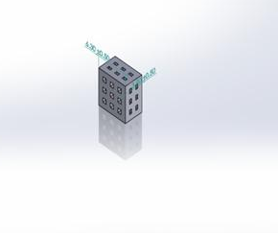
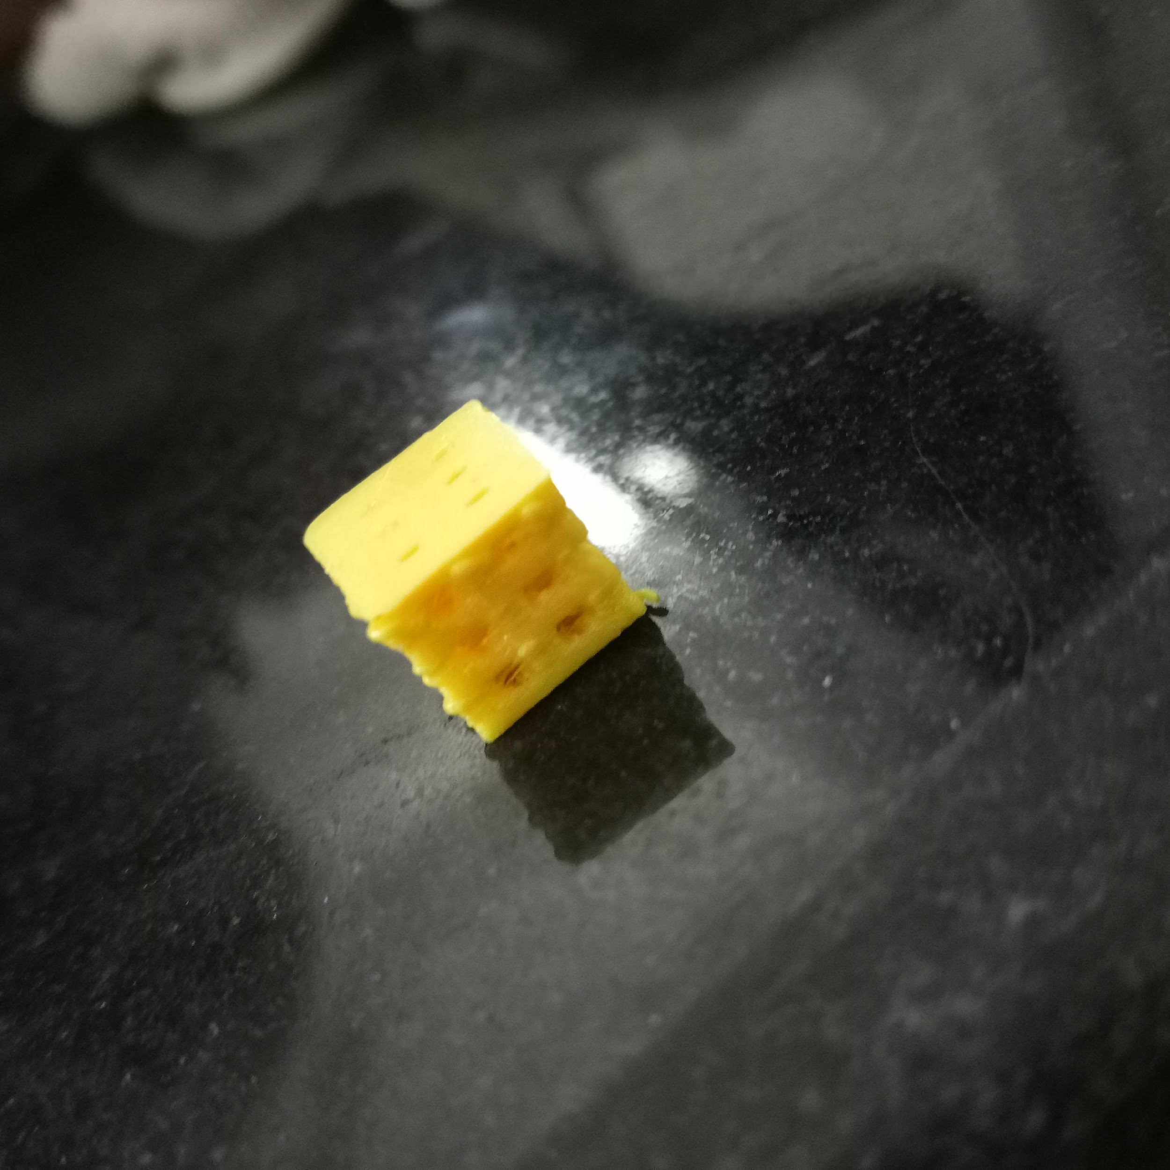
PREVIOUS WORK
Material selection
PLA
(poly lactic acid)
RESULTS
Reviewof literature
Printing Mehodology
FDM Printing
Designing of the porous scaffold
Using Solid works software
Figure 1. Designed model using solidworks
3D printing of scaffold design model
Ultimaker 2 FDM 3D printer used for printing the scaffold
Figure 2. 3D Printed scaffold
20BM283 - Mini project II

Slide 8
SOFTWARE SPECIFICATIONS
Software Specification:
Software | Description
ANSYS Work bench | Version 2024 R1
COMSOL | Version 4.1

Slide 9
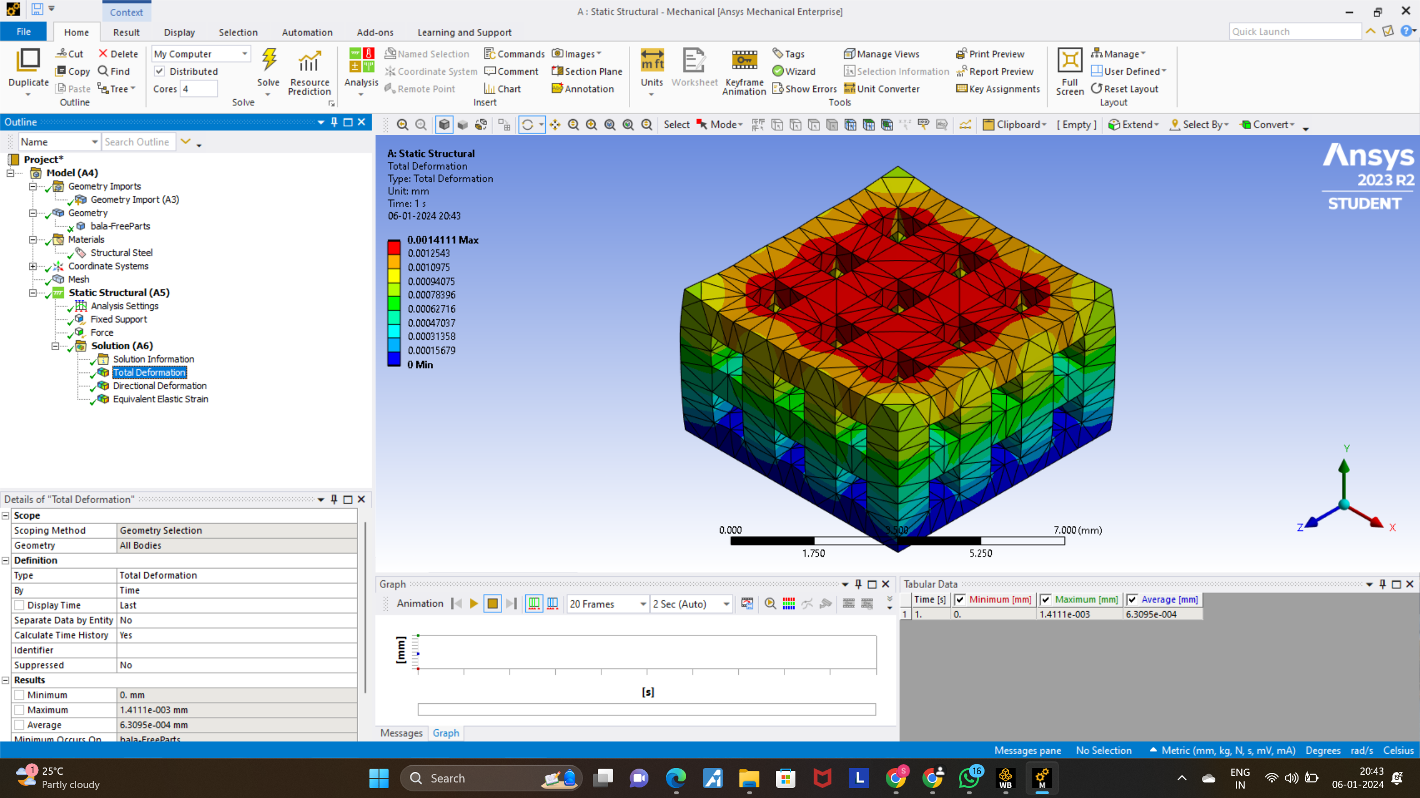
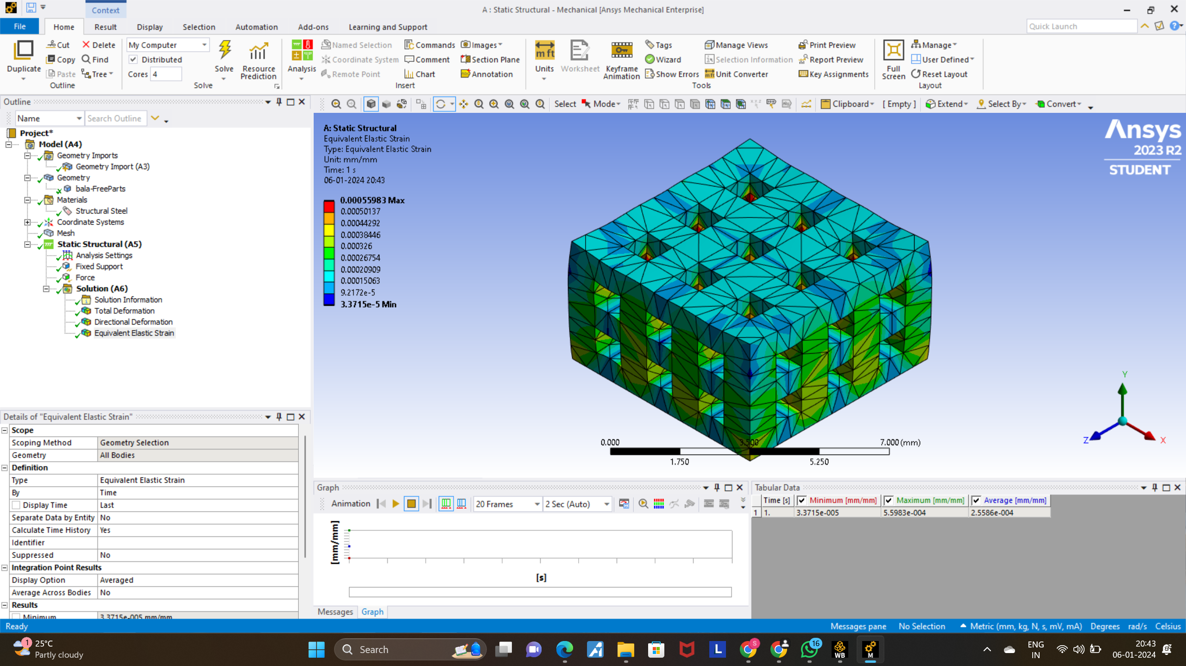
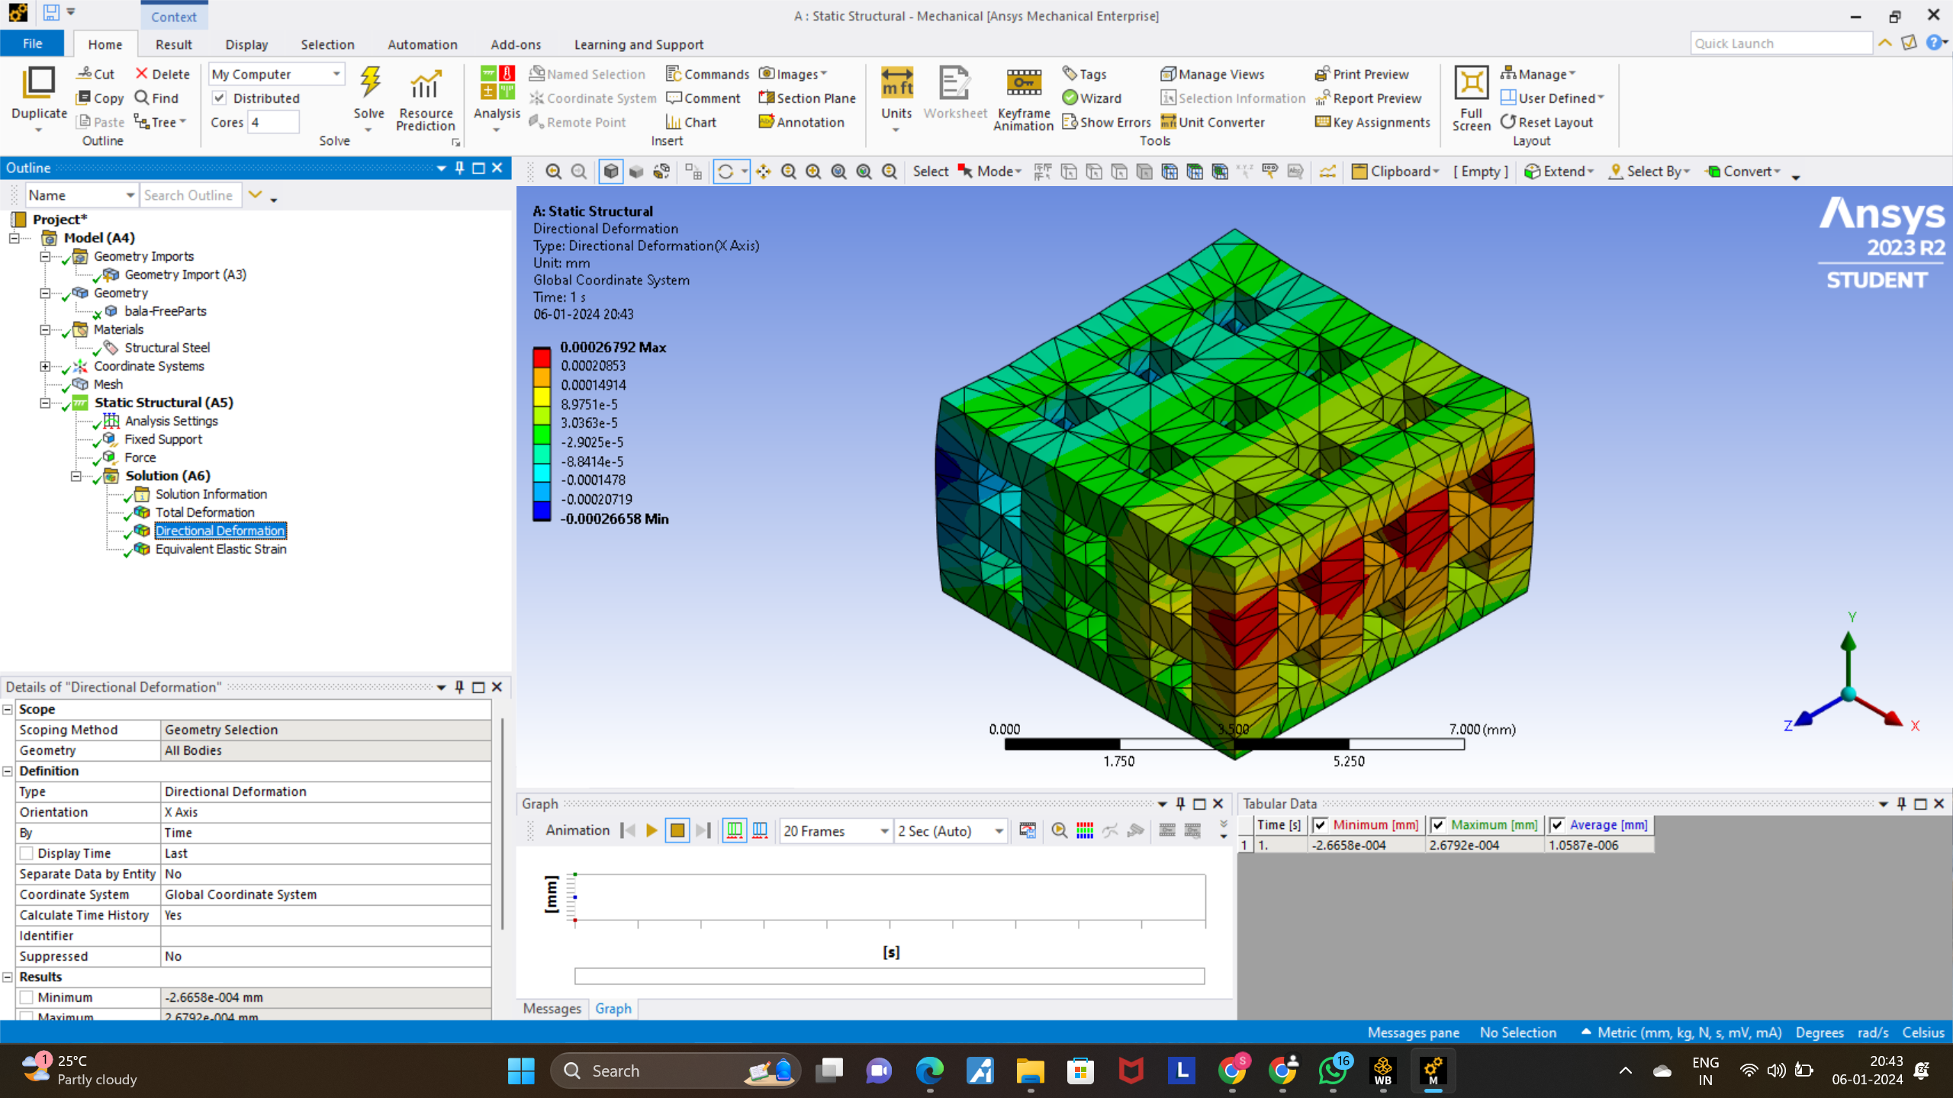
RESULTS AND DISCUSSION
Deformation Testing Using Ansys
a)Total deformation
Min:0
Max: 0.0014111
b)Equivalent Elastic Strain
Min:3.3715e-5
Max:0.00055983
c)Directional Deformation
Min: -0.00026658
Max:0.00026792

Slide 10
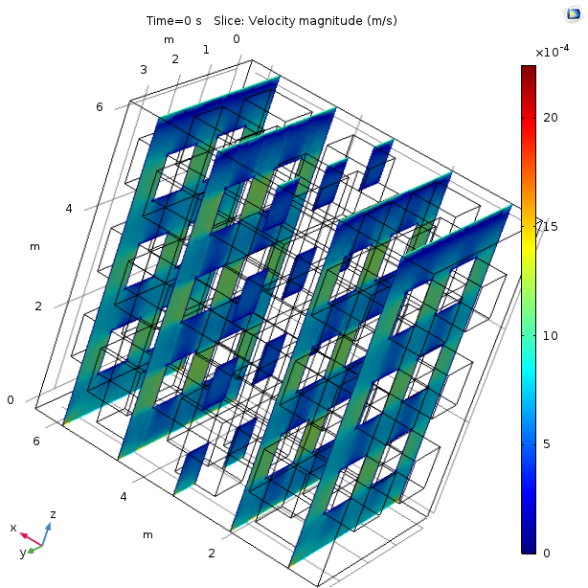
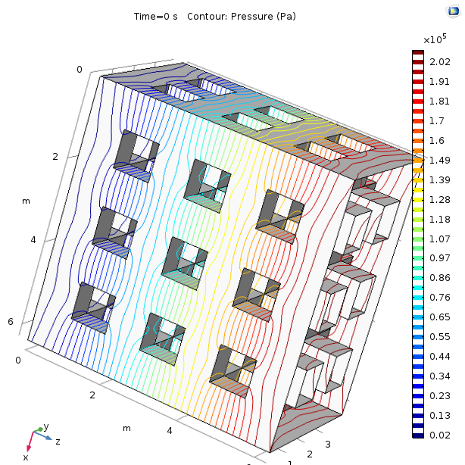
RESULT FLUID ANALYSIS
Fluid flow through different inlets
INLET 1
Velocity Magnitude(m/s)
Min :0 x 10^-4
Max:20 x 10^-4
Pressure(Pa)
Min :0.02 x 10^5
Max:2.02 x 10^5

Slide 11
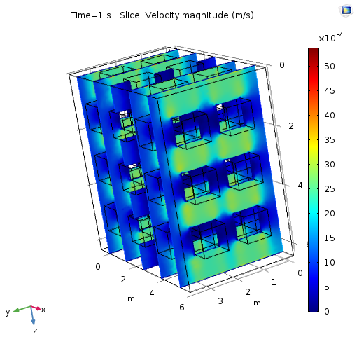
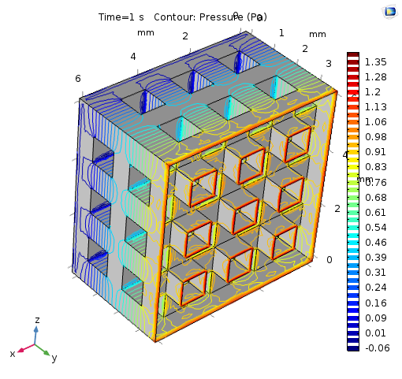
INLET 2
Velocity Magnitude(m/s)
Min :0 x 10^-4
Max:50 x 10^-4
Pressure(Pa)
Min : -0.06
Max: 1.35

Slide 12
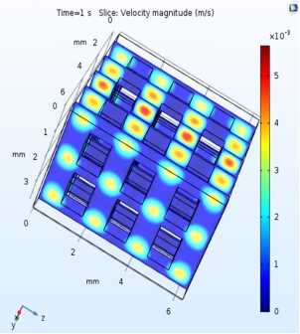
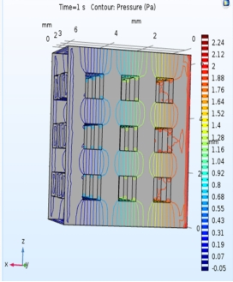
INLET-3
Velocity Magnitude(m/s) Pressure(Pa)
Min :0 x 10^-3 Min: -0.05
Max:5x 10^-3 Max: 2.24

Slide 13
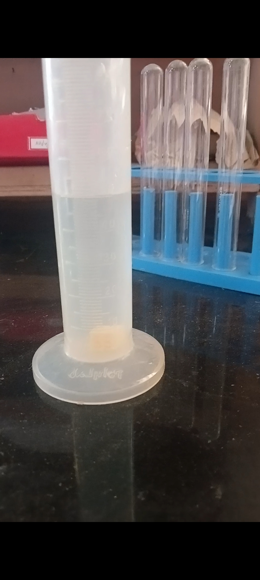
RESULT
Porosity Measurement -(in vitro)
Liquid displacement was utilized to assess the porosity of the PLA scaffolds produced. After five minutes of total ethanol immersion of the scaffold, the porosity was calculated using the following formula:
Porosity = (V1 − V2)/(V2 − V3) × 100%
where,
V1 = the volume of absolute ethanol
V2 = the total volume of the thoroughly impregnated scaffold into ethanol
V3 = residual volume of ethanol
Porosity Obtained : (60±1) %
Fig A: Scaffold Immersed in Ethanol

Slide 14
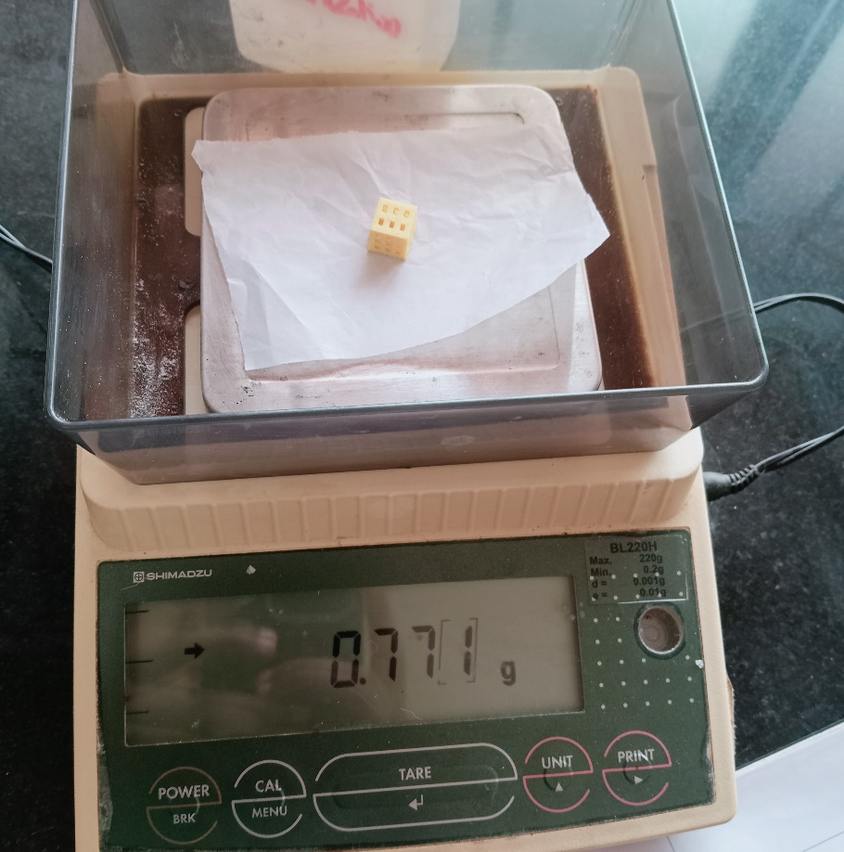
RESULTS
2. Water Absorption
Purpose:
Cellular Migration, Proliferation & Differentiation.
Biochemical transport and mechanical properties.
Water binding capacity of the scaffold.
Formula:
Water Absorption Percentage =((W2-W1)/W1)%
Where,
W1 - Wet weight of the scaffold
W2 - Dry weight of the scaffold
Fig B: Initial weight of the Scaffold

Slide 15
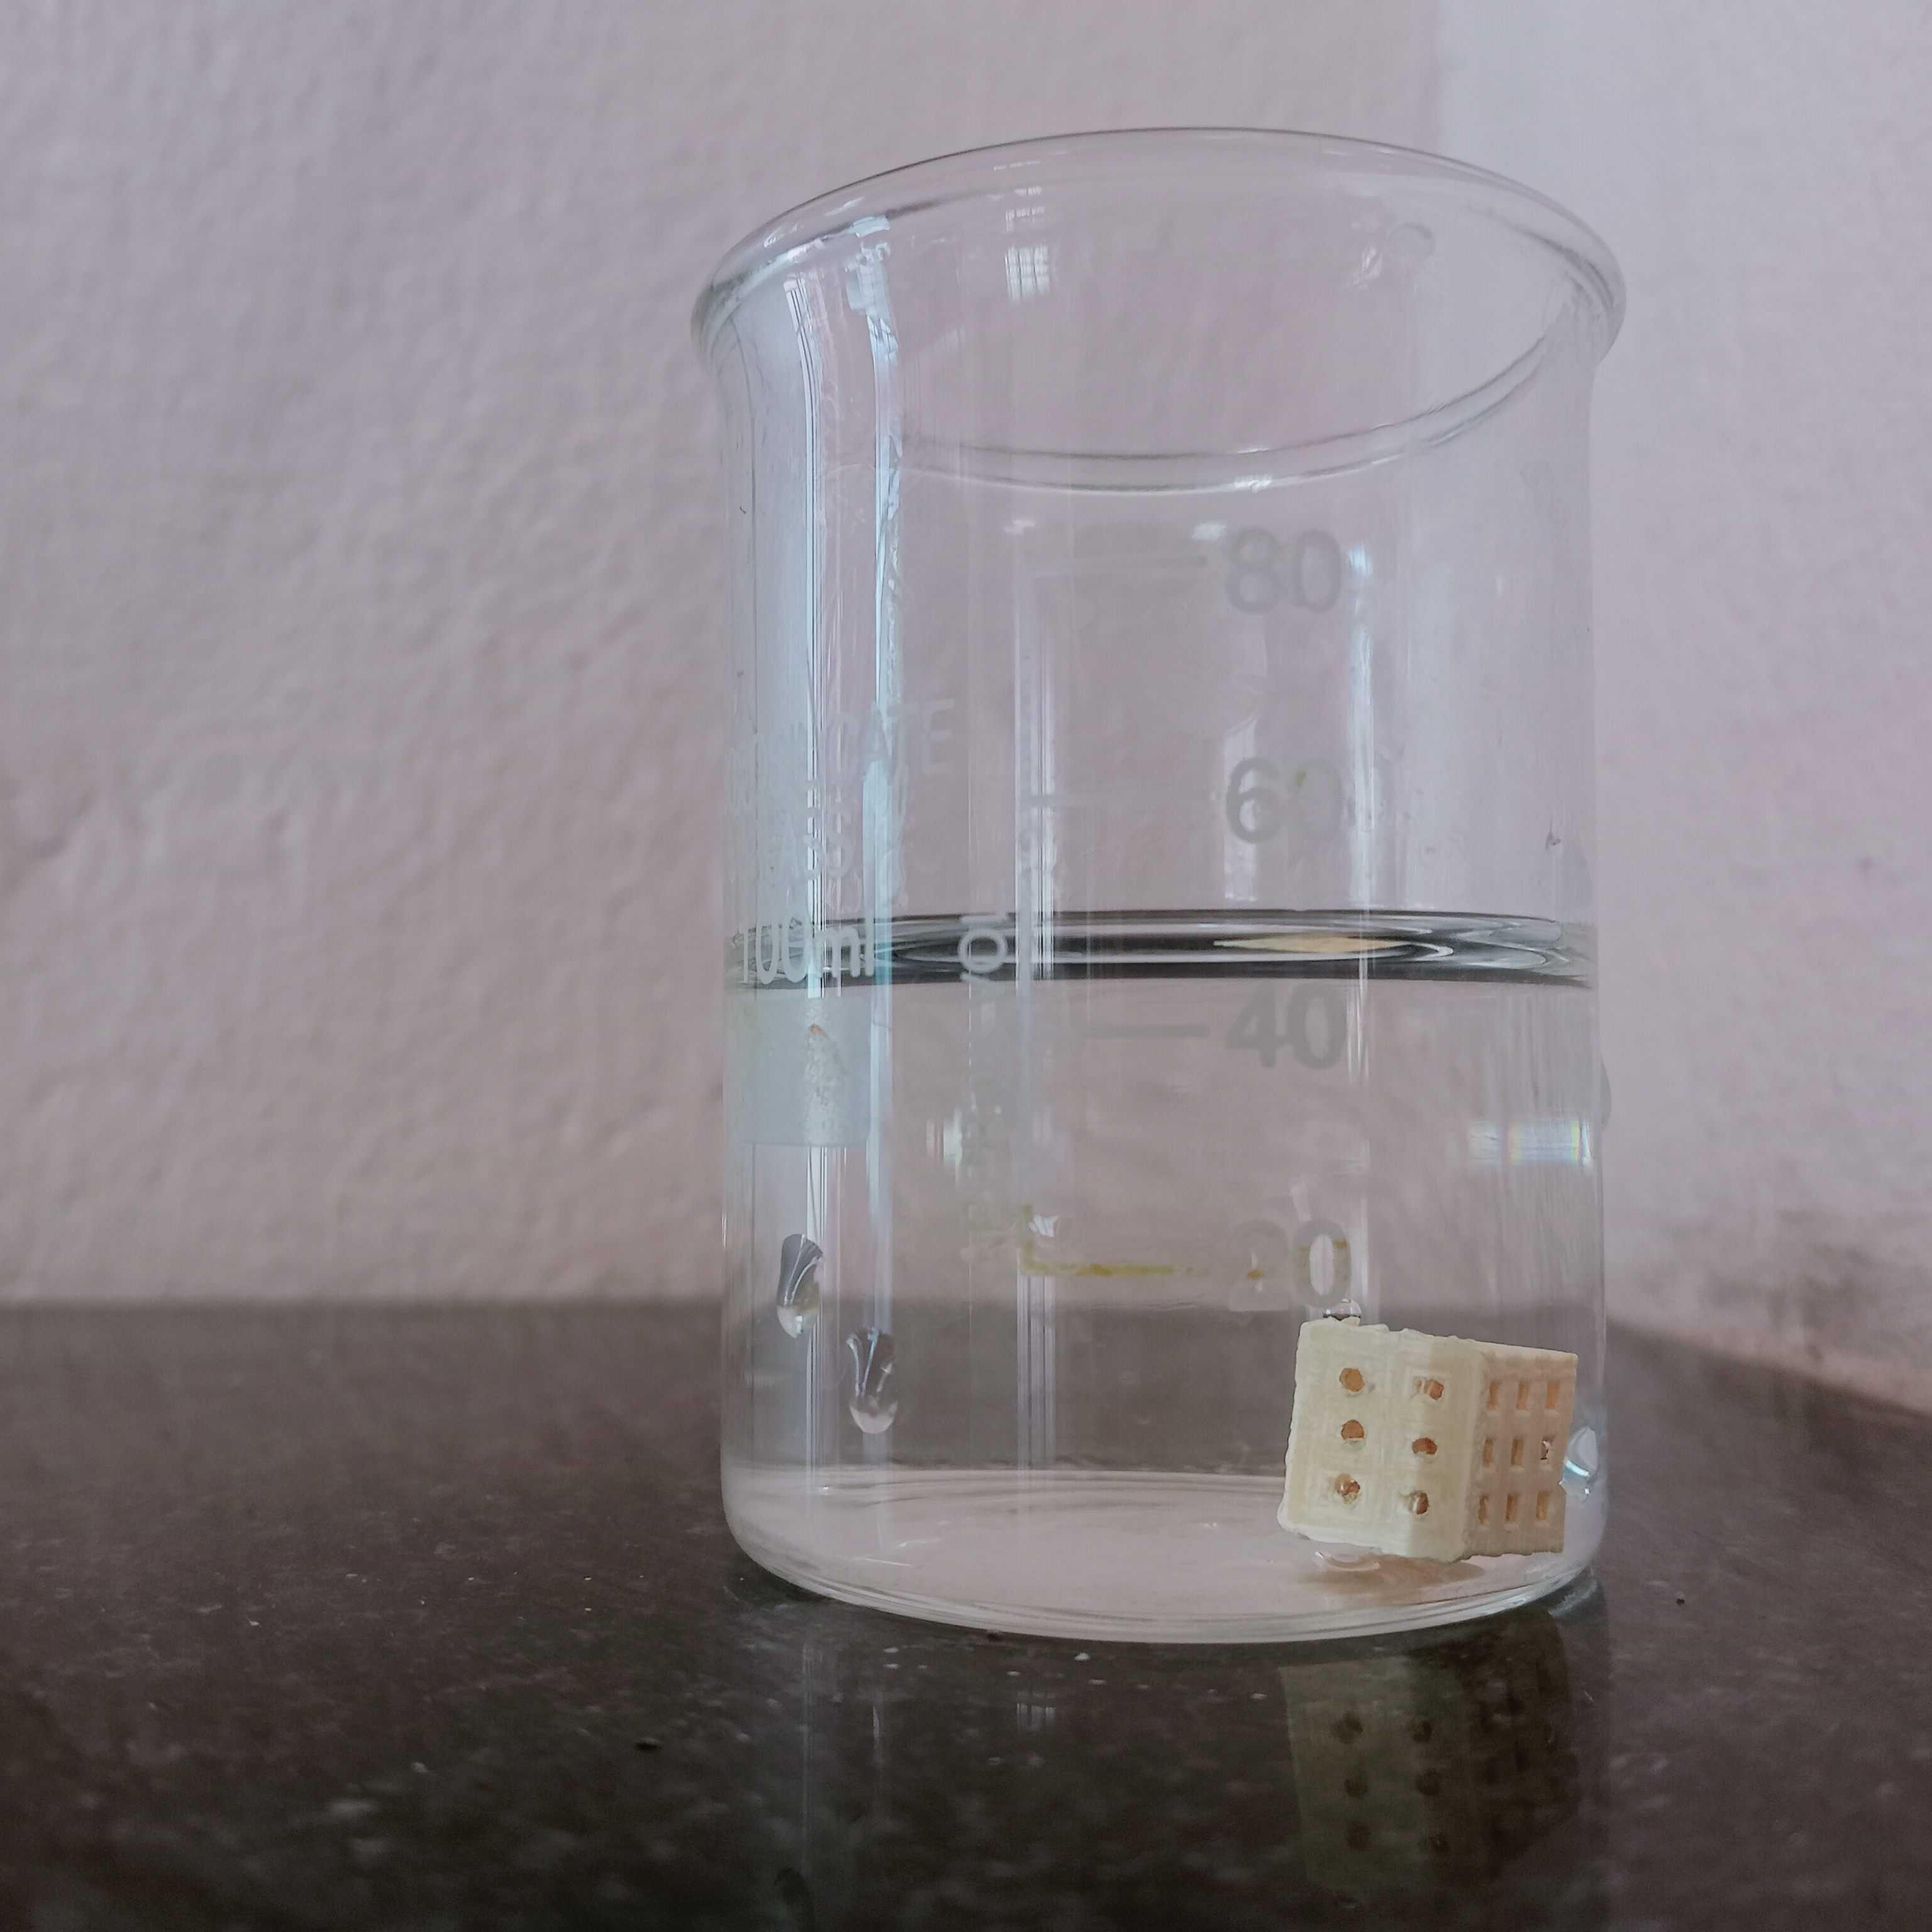
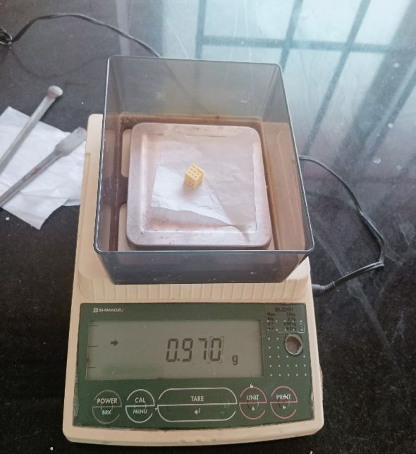
RESULTS
Conti…
Immerse for 10 hours
Scaffold Immersed in Distilled Water(50 ml)
Final Weight of the Scaffold after 10 hours of Immersion

Slide 16
Bar Graph Representation Water absorbtion test Results
Standare Deviation Error:17.04764565

Slide 17
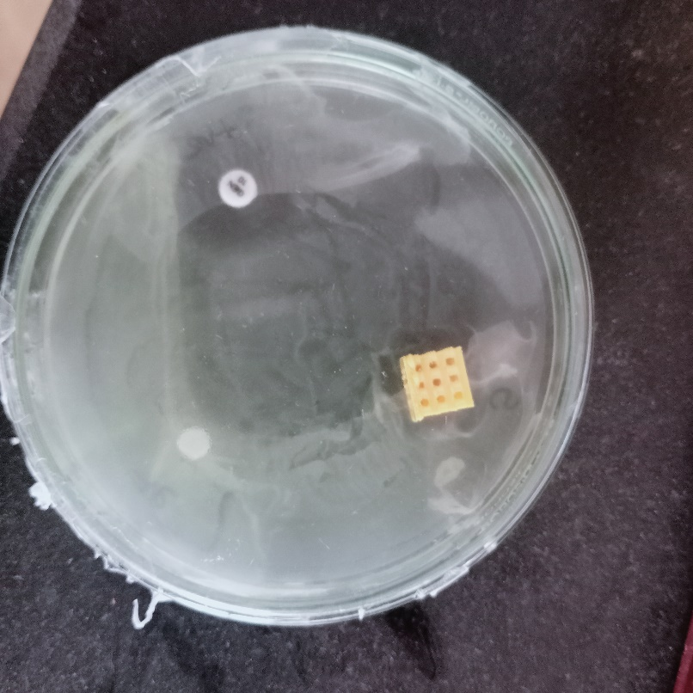
RESULT
3. Antimicrobial Testing
A modification of the Kirby–Bauer antibiotic sensitivity test.
Gentamycin Disc is the Positive Control used here.
DMSO(Di-Methyl-Sulfoxide) is the Negative Control used here.
Clinical isolates were cultured and Nutrient agar plates (100 mm) were prepared and 100 μL of bacterial suspension (1.5 × 108 CFU/mL) was spread across the plate to form a lawn culture.
Observed Zone of Inhibition
+ve control
Sample
-ve control
Fig C: Escherichia Coli (ATCC 25922) on PLA
scaffold incubated at 37 deg Celcius for 24 hours
Bacteria used | Zone of inhibition
E Coli | 1.2 cm

Slide 18
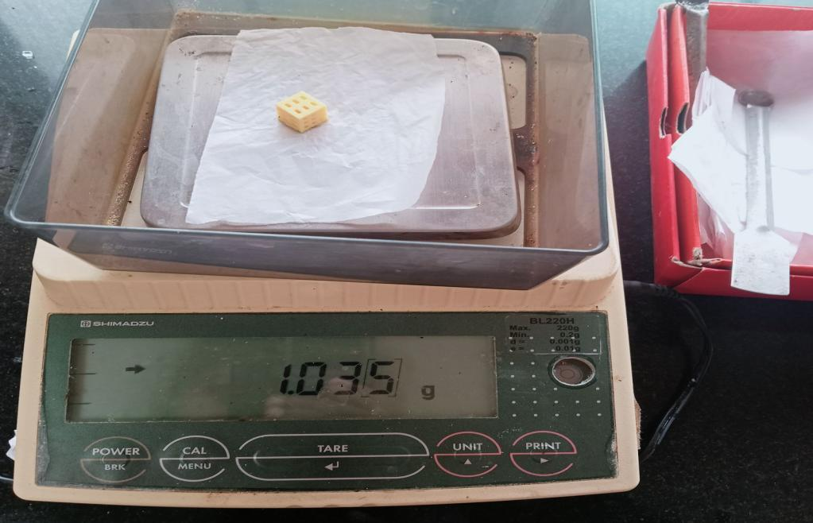
RESULT
4.Swelling study
Purpose:
This method helps evaluate the scaffold's ability to absorb fluids, which is important for applications such as drug delivery or tissue engineering.
By monitoring changes in size or weight, researchers can assess the extent of swelling exhibited by the scaffold and understand its response to different environmental conditions
Swelling study was calculated using the formula
DS= (w1-w2)/w2*100%
w1 and w2 are the wet and dry weight of the scaffold
Fig.Final result obtained in swelling study

Slide 19
Swelling Study Result Visual Representation

Slide 20
CONCLUSION AND FUTURE SCOPE
In this project, different characterization procedures that will used to asses the biocompatibility and performance, evaluation of scaffold - physical, mechanical, and biological properties.
FUTURE WORK(In vivo studies)
Bacterial Attachment studies
Cell culture (Toxicity against Bone cells)

Slide 21
REFERENCES
Senthil Maharaj Kennedy et al.,(2023),”Experimental and finite element analysis on the effect of pores on bio-printed polycaprolactone bone scaffolds https://doi.org/10.1016/j.bprint.2023.e00301.
Senatov et al.,(2020) "Mechanical properties and shape memory effect of 3D-printed PLA-based porous scaffolds”.
Ziqi Guo et al.,(2019), “Characterization of biodegradable poly(lactic acid) porous scaffolds prepared using selective enzymatic degradation for tissue engineering”.
Osman et al.,(2022), "Development and Characterization of Functional Polylactic Acid/Chitosan Porous Scaffolds for Bone Tissue Engineering." Polymers 14, no. 23 (2022): 5079.
R. Baptista et al.,(2022),“Morphological and mechanical characterization of 3D printed PLA scaffolds with controlled porosity for trabecular bone tissue replacement”.
Rushabh Patel .etal.,“Deformation behavior of porous PHBV scaffold in compression: A finite element analysis study”2019.https://doi.org/10.1016/j.jmbbm.2019.04.030
Chen, Heming et al.,(2019), "Degradation of 3D-printed porous polylactic acid scaffolds under mechanical stimulus." Frontiers in Bioengineering and Biotechnology 9 (2021): 691834.
Seyed-Iman Roohani-Esfahani,et al., June 2023 “Design and Fabrication of 3D printed Scaffolds with a Mechanical Strength Comparable to Cortical Bone to Repair Large Bone Defects” Med. 9, 66–76.
Rushabh Patel .etal.,“Deformation behavior of porous PHBV scaffold in compression: A finite element analysis study”2019.https://doi.org/10.1016/j.jmbbm.2019.04.030

Slide 22
THANK YOU

